Slide 1
CODE WARRIORS
ALEESHA Reez, northeastern university
Meghana KANDRU, northeastern university
SAHANA KANNAHALLIMOLE SOMANNA, northeastern university

Slide 2
Introduction
Overview of the problem statement
Developing a flexible learning portal where a registered user can customize and track their learning depending on their areas of interest. It is a platform of all the courses and resources where the users can interact with their co-learners and get rewards to recognize their achievements. Admin can add, delete or make any modifications to the learning portal.
Key features and requirements
Authentication and authorization system
Online learning resources
Flexibility of setting the timeline for the users to accomplish the goals
Dashboard to track the goals
Communication and Notification Platform

Slide 3
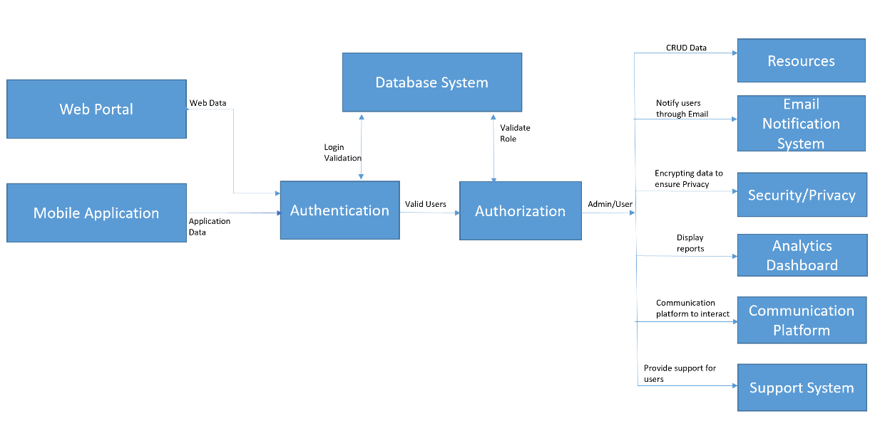
Architectural Components

Slide 4
Quality Attributes and Context of The Architecture
Availability
Security
Portability
Performance
Usability
Testability
Scalability
Agility
Supportability
Flexibility
Architecture pattern
Service oriented architecture which use REST API’s to communicate with various components of the system
Highly maintainable and testable - enables rapid and frequent development and deployment
Independently deployable
Capable of being developed by a small team

Slide 5
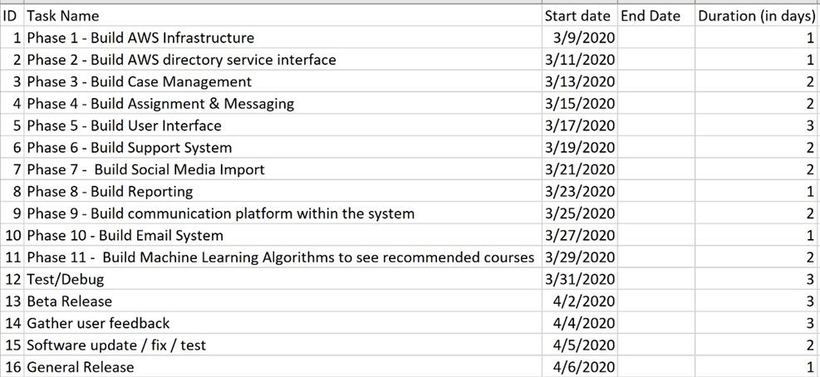
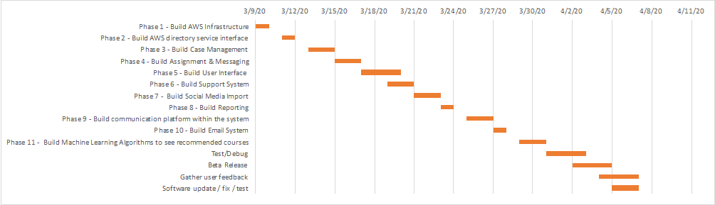
Execution PLAN

Slide 6
Technology choices
REST Architecture - In today’s world all distributed systems are communicating via REST API’s
AWS is preferred because of it’s high availability, durability, reliability and secure technology platform. AWS provides more free available options compared to other cloud service providers
Languages - HTML, CSS, JavaScript, AngularJS
Database - Amazon Relational Database Service (Amazon RDS)
Notification, Support - SendGrid is a cloud-based SMTP provider that allows you to send email without having to maintain email servers. We can send 40,000 emails for 30 days, then 100/day forever
Communication Platform – Amazon Chime
Authentication – Amazon Cognito
Authorization – AWS Identity Service
Security System – AWS Key Management Service

Slide 7
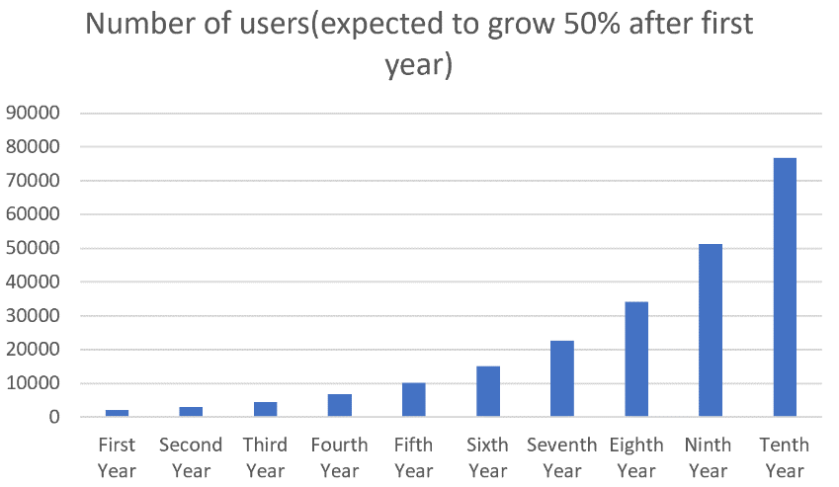
Graphical Representation of Users Growth
The system is expected to serve 2000 users in its first year, and after that grow by 50% per year.

Slide 8
Lessons learned
What were some of the gotchas?
Opportunity to build an end-to-end architecture for Learning Assistance System
The key deliverables included Business Requirement Document, Conceptual Architecture, Information Architecture, Software Architecture, Security Architecture, User Experience Architecture, Deployment Architecture and Technology Stack and Execution Plan.
What could you have done differently?
Provision for the users to add online resources
Features like quiz, tests and certifications, live seminars to attract more users

Slide 9
Future work
Real time integration with University’s library system
Provide more language options
Provision for the registered users to add online resources

Slide 10
References and Acknowledgements
https://www.mountaingoatsoftware.com/agile/user-stories
https://en.wikipedia.org/wiki/Scalability
https://msdn.microsoft.com/en-us/library/bb896744.aspx#anchor9
https://blog.turbonomic.com/blog/on-technology/cloud-scalability-scale-vs-scale
https://www.modernanalyst.com/Careers/InterviewQuestions/tabid/128/ID/1433/What-is-a-Context-Diagram-and-what-are-the-benefits-of-creating-one.aspx
https://www.lucidchart.com/pages/business-process-mapping

Slide 11

Thank you

Slide 12

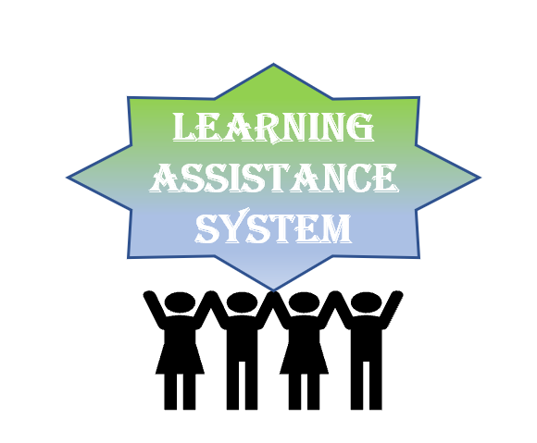
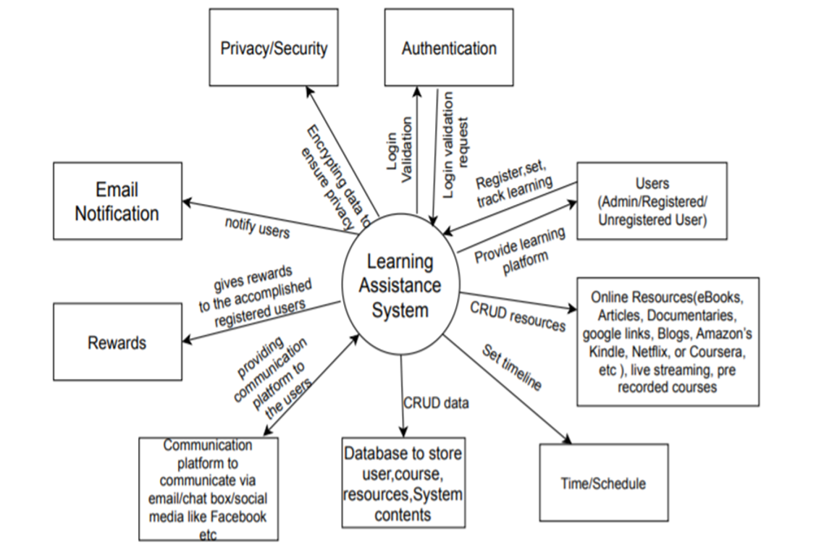






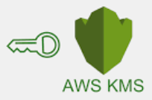
LEARNING ASSISTANCE SYSTEM
BY CODE WARRIORS
ALEESHA Reez, Meghana KANDRU & SAHANA KANNAHALLIMOLE SOMANNA
NORTHEASTERN UNIVERSITY
Abstract
Developing a flexible learning portal where a registered user can customize and track their learning depending on their areas of interest. It is a platform of all the courses and resources where the users can interact with their co-learners and get rewards to recognize their achievements. Admin can add, delete or make any modifications to the learning portal
Technology Stack
REST Architecture
Web service & App service - AWS
Languages - HTML, CSS, JavaScript, AngularJS
Database - Amazon Relational Database Service (Amazon RDS)
Notification, Support - SendGrid
Communication Platform – Amazon Chime
Authentication – Amazon Cognito
Authorization – AWS Identity Service
Security System – AWS Key Management Service
System Context diagram
Users growth
Software Architecture

